Slide 1
Prompt Engineering Playbook
Frameworks, Techniques & Industry Applications for Working with LLMs

Slide 2
Agenda
Why prompting matters: failure modes and the prompts-as-code mindset
RCTFC: a five-field prompt structure
Few-shot prompting: steering output with examples
Chain-of-thought: reasoning before answering
Prompt chaining: multi-call pipelines joined by code
Meta prompting: LLMs that write and refine prompts
Technique comparison
Industry prompt library: DevOps, IT infrastructure, Python backend, finance, HR, banking
Key takeaways

Slide 3
Same model, same task: the prompt decides whether the output is usable
VAGUE PROMPT
Summarize this incident.
LLM
same model
same weights
OUTPUT
Generic summary. The model guesses the audience, length, format and focus.
SPECIFIED PROMPT
Role: on-call SRE lead
Context: logs, timeline
Task: find root cause
Format: 5-bullet postmortem
Constraints: cite log lines
OUTPUT
Root cause, timeline and fix in the requested format, each claim tied to a log line.
Why: an LLM samples from P(output | prompt). Each missing detail widens that distribution, and the model falls back to the most generic continuation.

Slide 4
Five techniques, each fixing a different failure mode
TECHNIQUE
FAILURE IT FIXES
MECHANISM
Inside one prompt
RCTFC
Model guesses intent, audience and format
Explicit Role, Context, Task, Format, Constraints fields
Few-shot
Labels or style drift from what you want
2–5 input/output examples placed in the prompt
Chain-of-thought
Wrong answers on multi-step logic
Model writes intermediate steps before answering
Across multiple LLM calls
Prompt chaining
One prompt overloaded with a multi-stage job
Small sequential calls; code checks each handoff
Meta prompting
Hand-tuning prompts does not scale
An LLM generates, scores and rewrites prompts

Slide 5
Treat prompts as code: version, test and monitor every change
1 Write
Template with typed variables
2 Version
Stored in git, reviewed by PR
3 Evaluate
Run golden test set; gate on pass rate
4 Deploy
Pin model + prompt version together
5 Monitor
Log outputs, track failures and drift
Production failures become new test cases
WHAT THE TEAM GETS
Consistency
One template gives the same output shape across users and teams
Accuracy
The eval set catches regressions before a prompt ships
Efficiency
Fewer retries and fewer tokens per correct answer
Governance
Every prompt change is reviewed, logged and auditable

Slide 6
RCTFC: five prompt fields, each removing one guess the model would otherwise make
FIELD
WHAT IT PINS DOWN
IF MISSING, THE MODEL DEFAULTS TO
R
Role
Persona, expertise level, vocabulary
Generic assistant voice at shallow depth
C
Context
Data, background, current situation
Assumed or invented facts
T
Task
One concrete action and its scope
Answers a different question
F
Format
Output schema: bullets, table, JSON, length
Free-form prose your code must re-parse
C
Constraints
Tone, limits, exclusions, compliance rules
Over-length, off-tone or non-compliant output

Slide 7
A complete RCTFC prompt for a churn spike, and the output contract it creates
prompt.txt use case: Q3 churn spike
EXPECTED OUTPUT SHAPE
ROLE: You are a senior financial analyst with 10 years in SaaS metrics.
CONTEXT: Q3 churn and revenue by segment is attached as churn_q3.csv.
TASK: Explain the drivers behind the 12% rise in churn.
FORMAT: 3-bullet executive summary, then a table of key metrics.
CONSTRAINTS: Under 200 words. No jargon. Use only the attached data.
• Driver 1 + evidence
• Driver 2 + evidence
• Driver 3 + evidence
Segment
Q2 churn
Q3 churn
…
…
…
…
…
…
CHECKS YOU CAN AUTOMATE
✓ word_count <= 200
✓ bullet_count == 3
✓ has_table == True
✓ figures ⊆ churn_q3.csv

Slide 8
Few-shot prompting teaches a pattern with 2–5 examples in context, no retraining
Zero-shot
Examples: none
Weights changed: no
Setup cost: none
Use when: Task is common and easy to describe
Few-shot
Examples: 2–5, inside the prompt
Weights changed: no
Setup cost: minutes
Use when: Format or labels are easier to show than describe
Fine-tuning
Examples: hundreds to thousands
Weights changed: yes
Setup cost: days, GPUs, eval pipeline
Use when: High volume, stable task, prompt limits reached
FEW-SHOT PROMPT LAYOUT, ONE CONTEXT WINDOW
Instruction
Label: Low, Medium, High
Example 1
input → High
Example 2
input → Low
Example 3
input → Medium
New input
input → ?
Tips: balance labels across shots, keep every example in an identical format, and include one hard edge case. Order matters: the last shots weigh most.

Slide 9
Three labeled tickets are enough for the model to infer the urgency rule
Instruction: Classify each ticket as Low, Medium or High. Reply with the label only.
MODEL OUTPUT
High
Rule it inferred
users affected × time pressure, never written down
Output check
label ∈ {Low, Medium, High}
Shot 1 “Password reset link is broken; I need to log in for a client demo in 10 minutes.”
High
Shot 2 “Is there a way to export my data as a PDF instead of CSV?”
Low
Shot 3 “Dashboard charts load slowly since this morning, but they do load.”
Medium
New input “The app has been down for all users since this morning.”
?

Slide 10
Chain-of-thought trades extra tokens for accuracy: 3× on grade-school math
Standard question → answer
GSM8K math accuracy, PaLM 540B
Q
A
Chain-of-thought steps written before the answer
Q
step 1
step 2
step 3
A
Self-consistency sample N paths, majority vote
path 1 → 42
Q
vote 2 of 3
42
path 2 → 42
path 3 → 38
Cost: CoT multiplies output tokens; voting multiplies them by N.
Reasoning models (o-series, Claude extended thinking) do CoT internally.
Self-consistency samples 40 paths. Source: Wei et al., Chain-of-Thought Prompting Elicits Reasoning in LLMs, NeurIPS 2022; Wang et al., Self-Consistency Improves CoT Reasoning, ICLR 2023.

Slide 11
A step-by-step trace turns a latency spike into a checkable root cause
PROMPT API p99 latency jumped from 200 ms to 4 s at 09:15. Let's think step by step to find the root cause.
STEP 1
Check deploys
A build shipped at 09:10, five minutes before the spike
STEP 2
Check infra metrics
CPU and memory are normal
STEP 3
Check dependencies
Payments service p99 spiked at 09:12
STEP 4
Correlate
The 09:10 build added a synchronous call to payments
Suspect
Ruled out
Suspect
Root cause
Conclusion Roll back the 09:10 build, then make the payments call asynchronous with a timeout.
Why it helps: every step is a claim you can verify against dashboards, so a wrong step shows up in the trace instead of hiding in the answer.

Slide 12
Prompt chaining splits a task into small LLM calls, with code checking every handoff
LLM call
code gate
LLM call
tool call
LLM call
Input
Extract
valid?
Transform
DB lookup
Generate
Output
pass → typed JSON forward
fail → retry with the error message
Chain-of-thought
Prompt chaining
LLM calls
One
One per step
State between steps
Inside one response
Passed and checked by your code
Debugging
Read the whole trace
Test and log each step on its own
Can add
Nothing mid-way
Validation, branching, retries, tools

Slide 13
Four typed steps turn raw meeting notes into a sprint plan
Input: raw meeting notes, free text
STEP 1
Extract
Pull every requirement from the notes
Output
requirements[]
{id, text, owner}
STEP 2
Draft user stories
Turn requirements into backlog items
Output
stories[]
{as_a, i_want, so_that}
STEP 3
Estimate effort
Assign story points by complexity
Output
{story_id: points}
STEP 4
Generate sprint plan
Fit stories into the next sprint
Output
sprint_plan.md
✓ each item has an owner
✓ every req maps to a story
✓ n ∈ {1, 2, 3, 5, 8}
✓ total ≤ team capacity
Code checks each output before the next call
Payoff: a bad estimate is caught at step 3 and rerun alone, instead of corrupting the plan. Cost: four calls instead of one.

Slide 14
Meta prompting puts an LLM in the loop that writes, scores and rewrites prompts
1 Generate
Generator LLM drafts prompt variants from the task spec
2 Run
Each variant runs on a fixed eval set of inputs
WHERE TEAMS USE IT
Rewrite vague prompts into RCTFC form
Generate few-shot examples at scale
Re-tune prompts when switching models
Agents writing their own sub-task prompts
Loop until scores stop improving
4 Critique
Critic LLM reads failures and proposes edits
3 Score
Exact-match metrics or an LLM judge grade outputs
Ship: prompt v2, versioned in git
Guardrail: score on a held-out test set the loop never sees, or the prompt overfits to the eval examples.

Slide 15
One meta-prompt turns a six-word request into a complete RCTFC prompt
ORIGINAL PROMPT
Write something about our sales numbers.
META-PROMPT
You are a prompt engineering expert. Rewrite the prompt for clarity, specificity and output format. Explain each change.
REWRITTEN PROMPT
Role: Senior FP&A analyst.
Context: Q3 sales by region, attached.
Task: Identify the top 3 revenue drivers.
Format: 3 bullets + a summary table.
Constraints: Under 150 words.
CHANGE LOG RETURNED WITH THE PROMPT
+ Role sets domain expertise and vocabulary
+ Context grounds the answer in real Q3 data
~ Task replaces “something” with a measurable ask
+ Format fixes the output shape for downstream use
+ Constraints caps length so the answer stays scannable

Slide 16
Use the lightest technique that fixes the failure; cost rises with each step down
Technique | Best for | LLM calls | Token cost | Main risk
RCTFC | Any single prompt | 1 | Low | Long prompts nobody maintains
Few-shot | Format, labels, style | 1 | Low to medium | Model copies quirks of the examples
Chain-of-thought | Multi-step logic, diagnosis | 1, or N with voting | Medium to high | Plausible steps, wrong answer
Prompt chaining | Multi-stage workflows | 2 or more | Medium | Latency adds up per step
Meta prompting | Optimizing prompts at scale | Many, offline | High upfront | Overfits to the eval set
Techniques stack: a production chain usually uses RCTFC prompts with few-shot examples at each step.

Slide 17
Industry Prompt Library
18 ready-to-use RCTFC prompts, three each for DevOps, IT infrastructure, Python backend, finance, HR and banking

Slide 18
Industry Prompt Library: DevOps
1. Incident Root-Cause Analysis
2. CI/CD Pipeline Optimization
3. Infrastructure-as-Code Review
Role: Senior DevOps SRE
Context: Incident logs and timeline attached
Task: Identify the most likely root cause of the outage
Format & Constraints: Timeline table + root cause statement; flag assumptions
Role: CI/CD platform engineer
Context: Current Jenkins pipeline YAML attached
Task: Suggest changes to cut build time by 30%
Format & Constraints: Numbered list with expected impact; must stay backward-compatible
Role: Terraform security reviewer
Context: .tf files attached
Task: Review for security misconfigurations and cost waste
Format & Constraints: Table of Issue / Severity / Fix; cite line numbers

Slide 19
Industry Prompt Library: IT Infrastructure
1. Capacity Planning
2. Network Troubleshooting Guide
3. Disaster Recovery Runbook
Role: Infrastructure capacity planner
Context: 6-month server utilization trend data
Task: Forecast when we exceed 80% capacity
Format & Constraints: One paragraph + trend summary; assume 15% MoM growth
Role: Senior network engineer
Context: Intermittent latency between Region A and Region B
Task: Produce a step-by-step diagnostic checklist
Format & Constraints: Ordered checklist, max 10 steps; non-disruptive checks first
Role: Business continuity architect
Context: Primary data-center outage scenario
Task: Draft a DR failover runbook for the payments system
Format & Constraints: Numbered runbook, owner + SLA per step; RTO under 4 hours

Slide 20
Industry Prompt Library: Backend Development (Python)
1. Code Review
2. REST API Design
3. Debugging Assistant
Role: Staff Python engineer
Context: Function or module pasted below
Task: Review for bugs, performance, and PEP8 compliance
Format & Constraints: Bullets grouped by severity; include fix code snippets
Role: Backend architect
Context: Order-management REST API for a Django app
Task: Design the endpoint schema
Format & Constraints: Table of Method / Endpoint / Request / Response; RESTful, paginated
Role: Python debugging expert
Context: Traceback and relevant code pasted below
Task: Identify the root cause of the exception
Format & Constraints: Explanation + corrected code block; don't change unrelated logic

Slide 21
Industry Prompt Library: Finance
1. Variance Analysis
2. Financial Model Sanity Check
3. Earnings Call Summary
Role: Senior FP&A analyst
Context: Q3 actuals vs. budget by department
Task: Explain the top 3 variance drivers
Format & Constraints: 3-bullet summary + table; under 150 words, no speculation
Role: Financial modeling reviewer
Context: DCF model assumptions attached
Task: Flag unrealistic or inconsistent assumptions
Format & Constraints: Table of Assumption / Concern / Suggested Range; cite benchmarks
Role: Equity research associate
Context: Earnings call transcript attached
Task: Summarize management's key guidance
Format & Constraints: 5 bullets, one per theme; under 20 words each

Slide 22
Industry Prompt Library: HR
1. Job Description Generator
2. Performance Review Draft
3. Policy Q&A Assistant
Role: Talent acquisition specialist
Context: Hiring mid-level Data Engineer, fintech startup
Task: Draft the job description
Format & Constraints: Summary / Responsibilities / Requirements sections; inclusive, under 400 words
Role: HR business partner
Context: Manager's raw notes on employee performance
Task: Draft a structured performance review
Format & Constraints: Strengths / Growth Areas / Rating rationale; constructive tone
Role: Internal HR policy assistant
Context: Company parental-leave policy document
Task: Answer employee eligibility questions
Format & Constraints: Direct answer + policy citation; say “unclear” if unsure

Slide 23
Industry Prompt Library: Banking
1. Loan Risk Summary
2. Regulatory Change Digest
3. Customer Complaint Response
Role: Credit risk analyst
Context: Applicant financials & credit history
Task: Summarize key risk factors for this loan
Format & Constraints: Risk narrative + red-flag bullets; fair-lending compliant, no protected-class inferences
Role: Compliance officer
Context: New regulatory bulletin attached
Task: Summarize what changes & who's affected
Format & Constraints: Impact table by department; cite the regulation section
Role: Resolutions specialist
Context: Complaint about a disputed transaction
Task: Draft a response resolving the complaint
Format & Constraints: Empathetic opening + resolution steps; meet the 15-business-day SLA

Slide 24
Key takeaways
01
Structure every prompt with RCTFC.
Most bad output traces back to a missing role, context or format.
02
Match the technique to the failure.
Examples for format, CoT for multi-step logic, chaining for multi-stage work, meta prompting for scale.
03
Treat prompts as code.
Version them in git, review every change and gate releases on an eval set.
04
Start from the library, not a blank page.
Adapt the 18 domain prompts to your own data and constraints.
This week: pick one recurring task, write its RCTFC prompt and build a 20-case eval set for it.

Slide 25
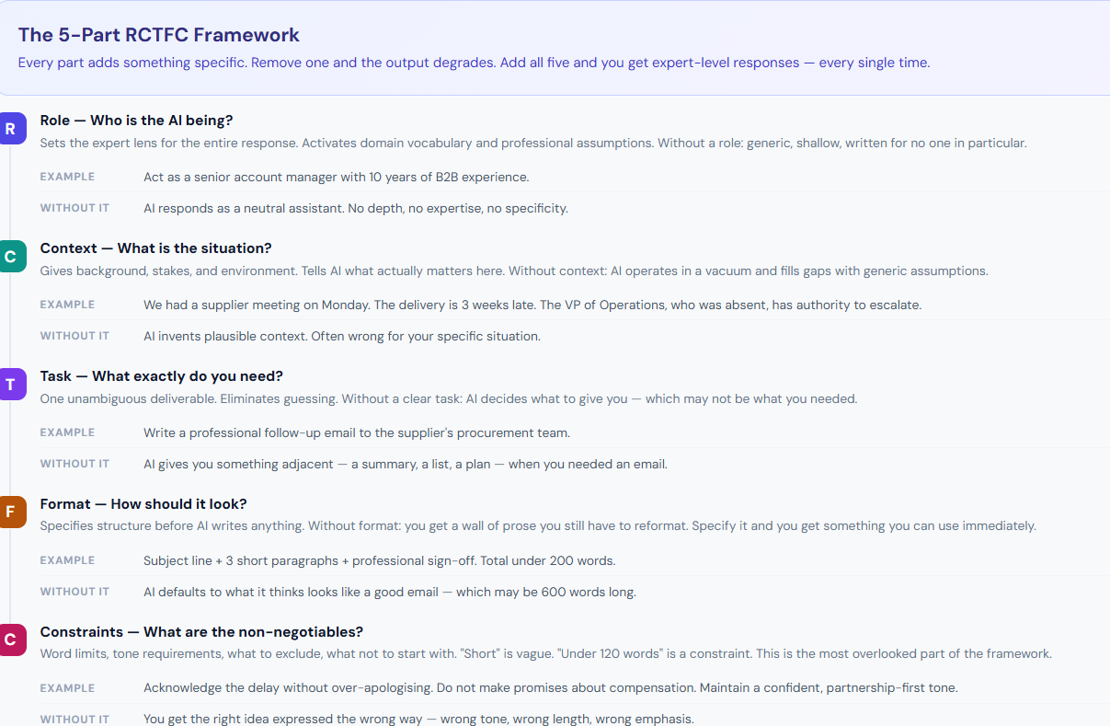

Slide 26
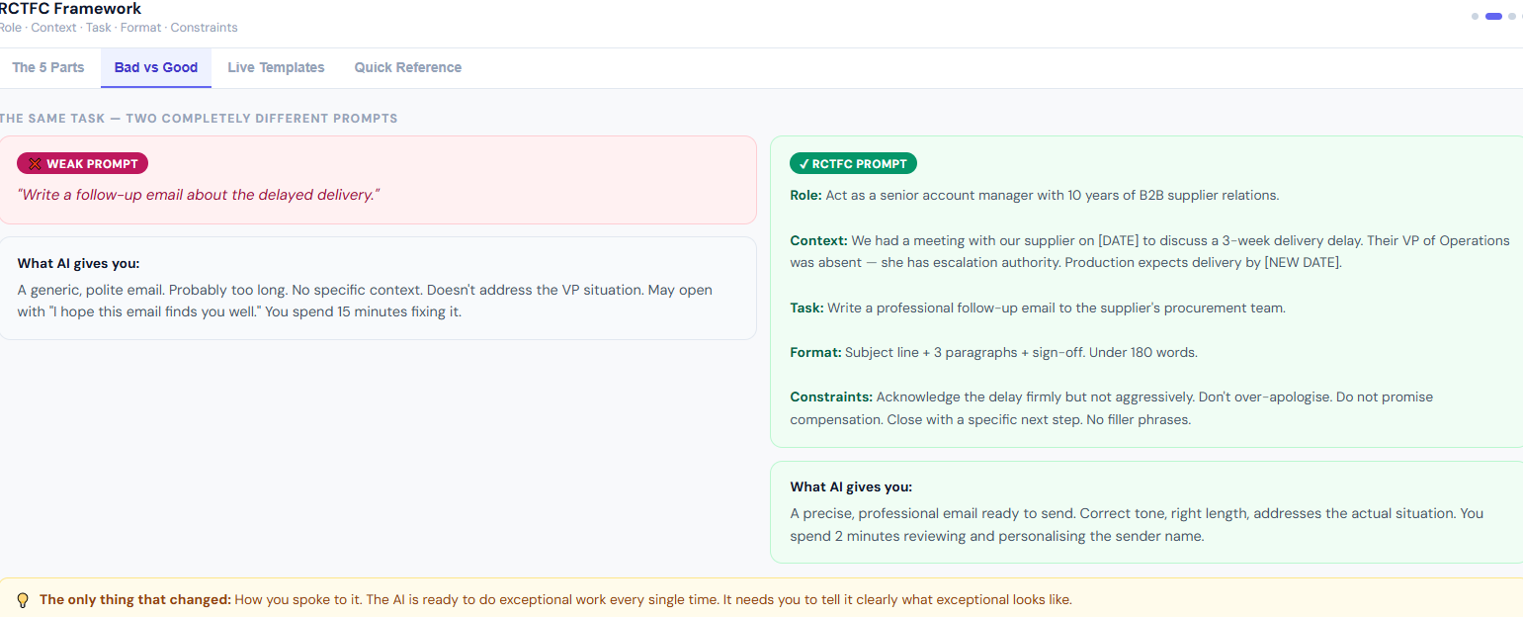

Slide 27
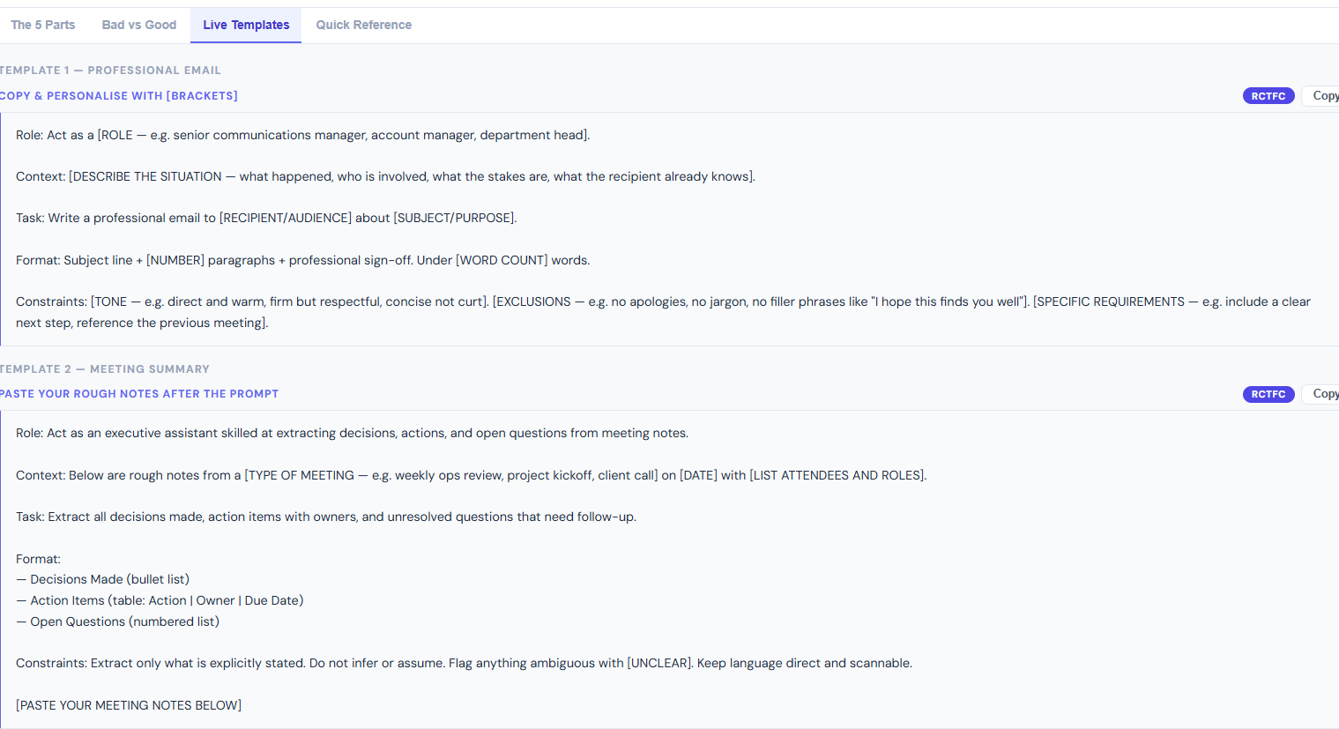

Slide 28
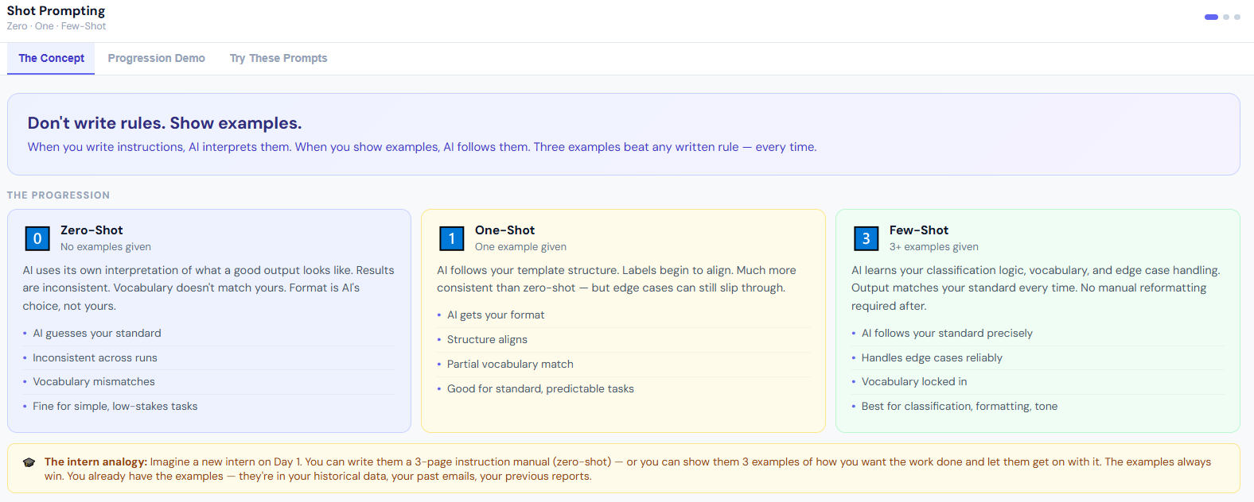

Slide 29
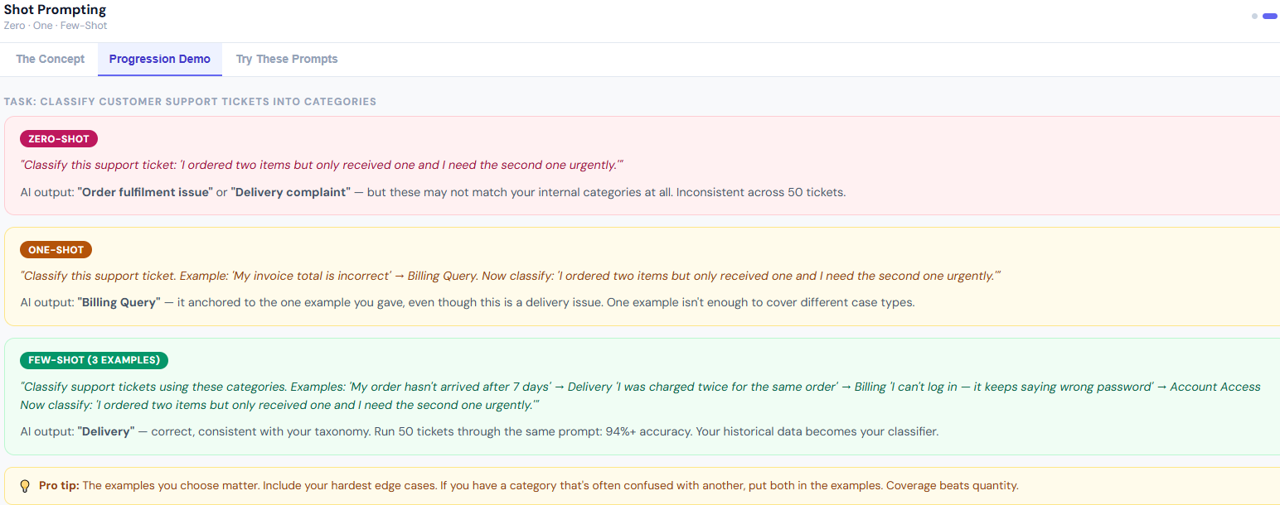

Slide 30
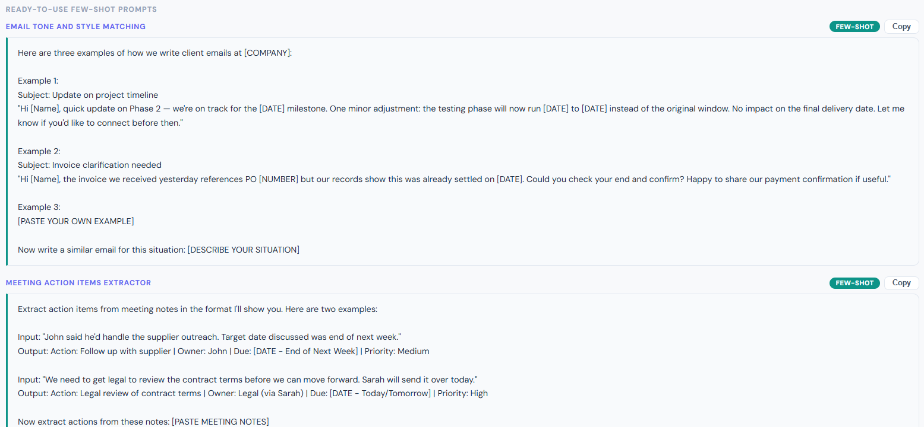

Slide 31
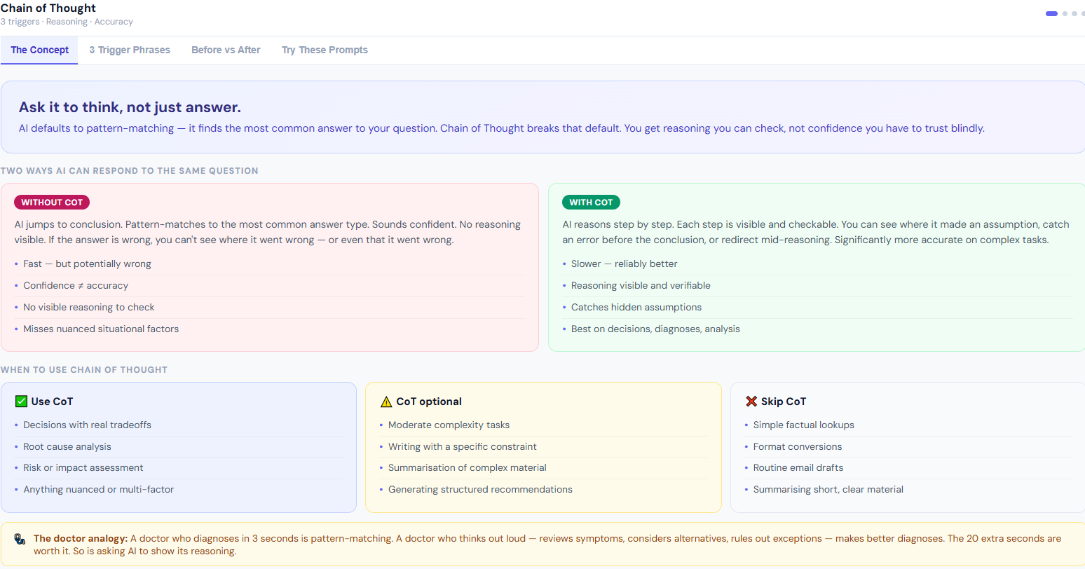

Slide 32
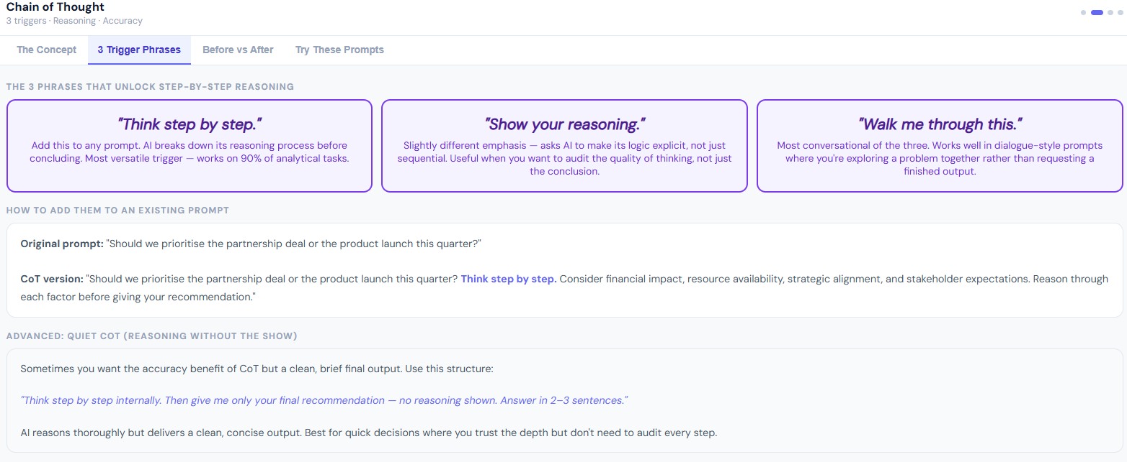

Slide 33
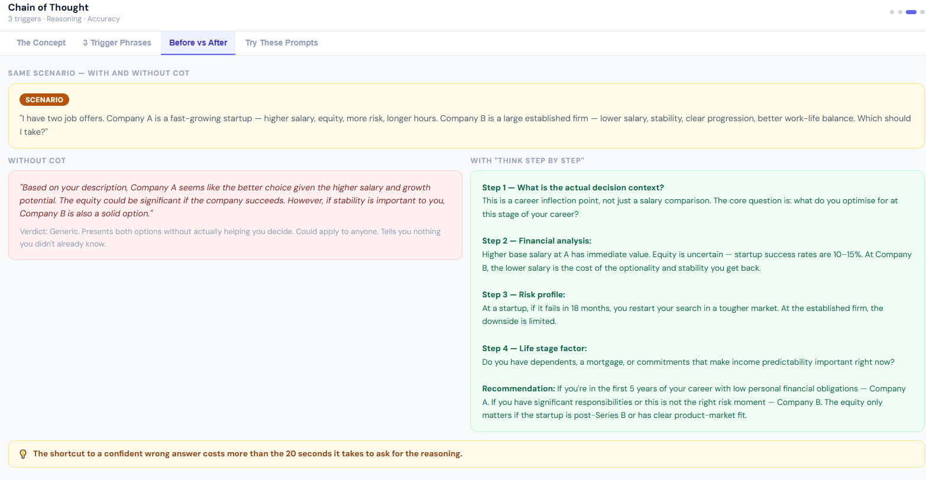

Slide 34
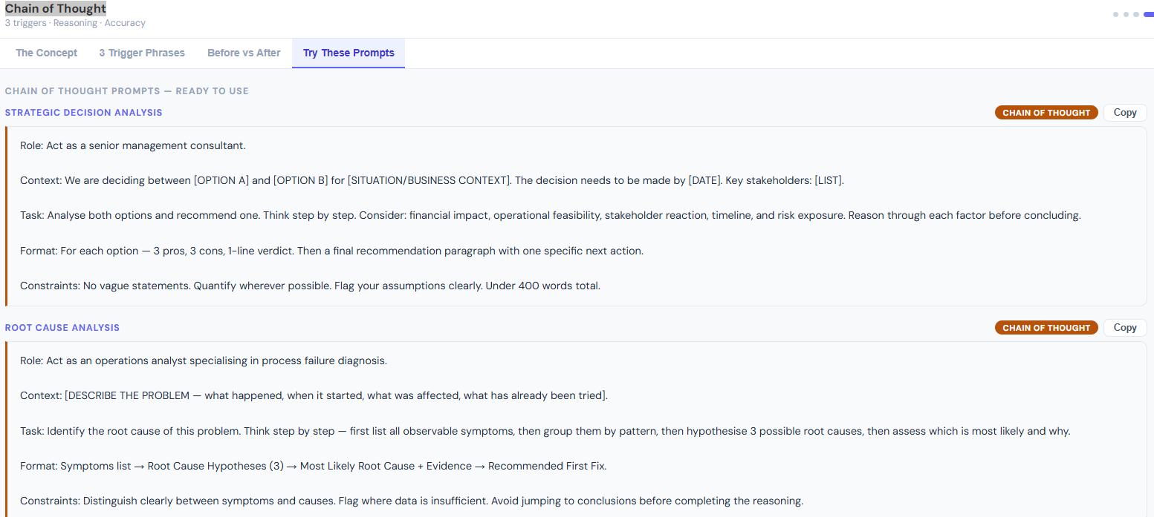

Slide 35
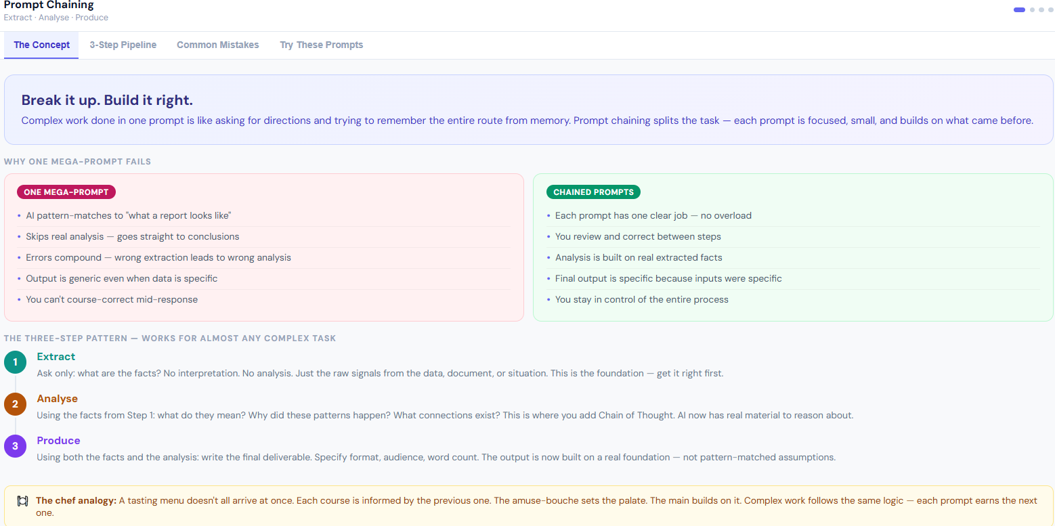

Slide 36
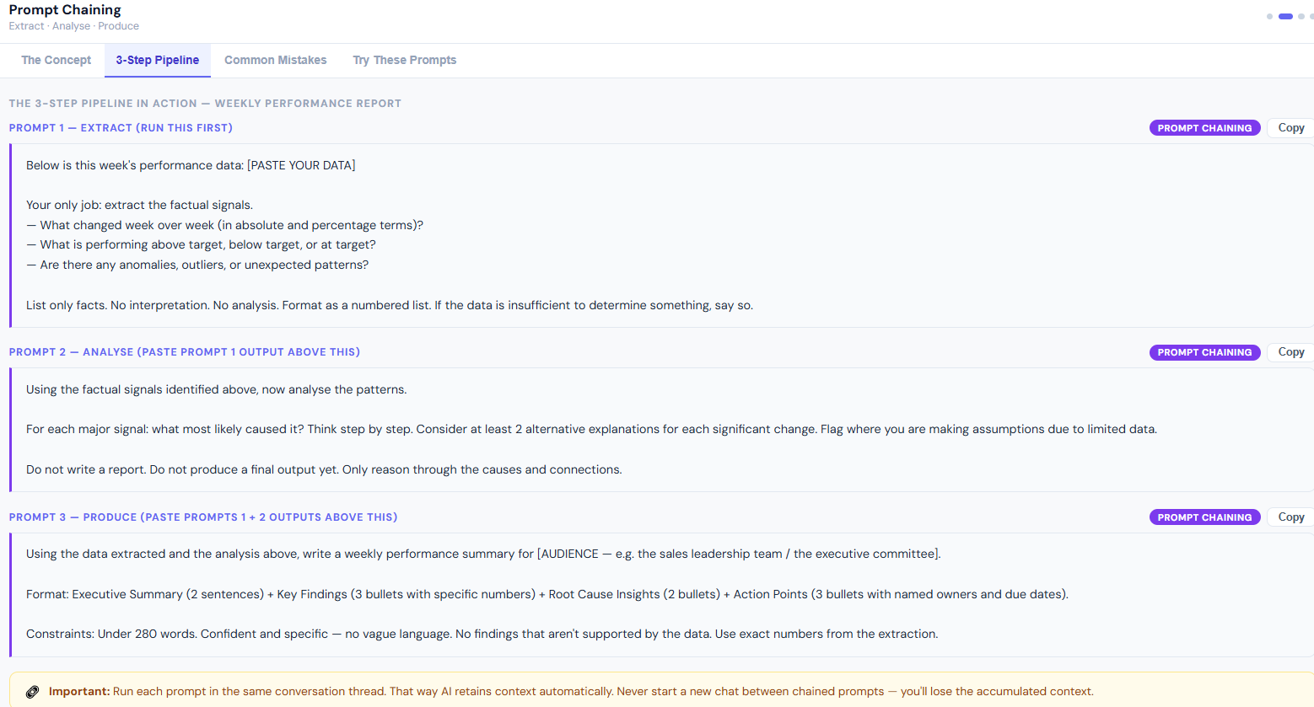

Slide 37
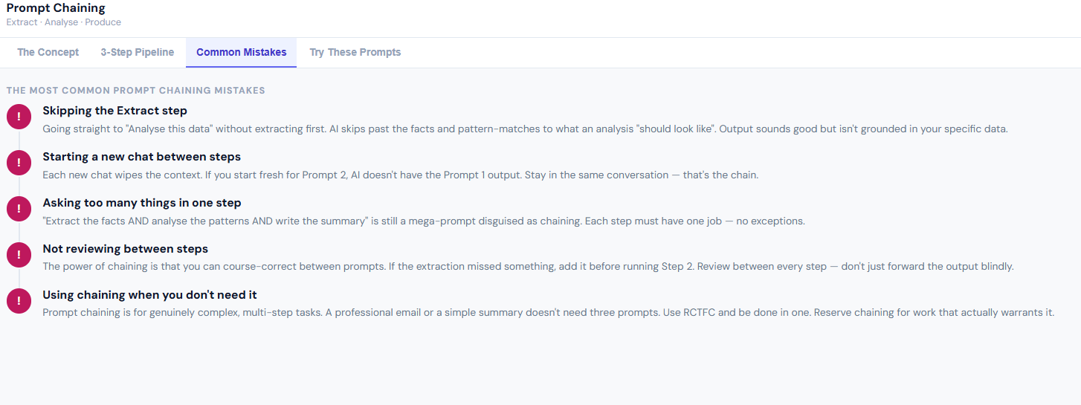

Slide 38
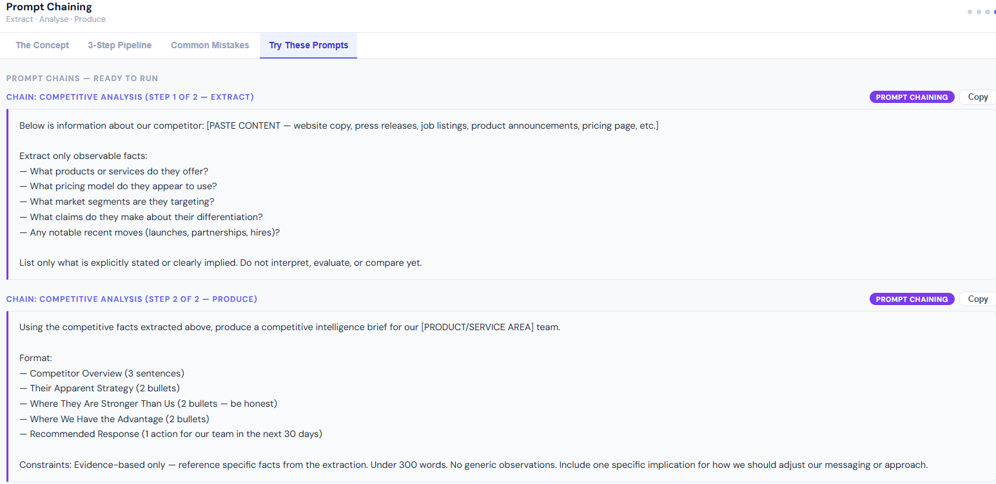

Slide 39
Thank You
Questions & Discussion

